Slide 1
Edge detection
NA project Mariam Borshkova

Slide 2
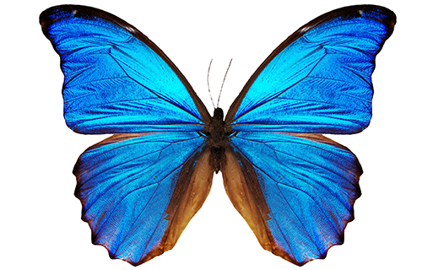
Original Image

Slide 3

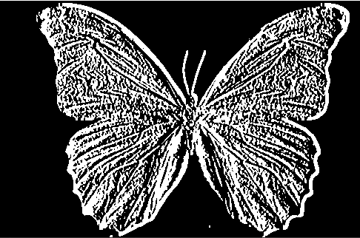

Sobel edge detection
It works by computing the gradient of the image intensity at each pixel using convolution with a pair of 3x3 kernels.
When kernel size is 3 . Sobel X
X-Direction Kernel
Y-Direction Kernel

Slide 4
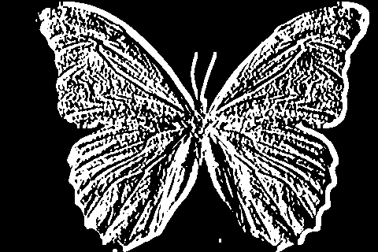
When kernel size is 5. Sobel X
1st derivative Sobel image in the x-direction.

Slide 5


Sobel Y. Kernel size is 3
1st derivative Sobel image in the y-direction.
Sobel Y. Kernel size is 5

Slide 6

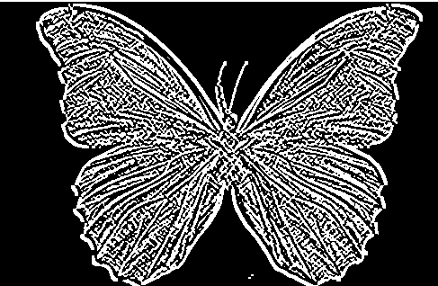
1st derivative Sobel image in both directions
Sobel X Y using Sobel() function, kernel = 3
Sobel X Y using Sobel() function, kernel = 5

Slide 7
Canny edge detection
Noise Reduction
Calculating the Intensity Gradient of the Image
Suppression of False Edges
Hysteresis Thresholding

Slide 8

Canny edge detection

Slide 9
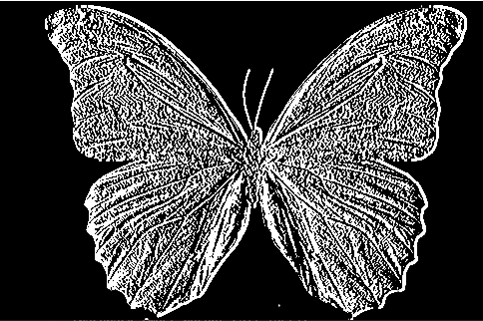

Schar algorithm kernel-based method for edge detection
X gradient
Y gradient

Slide 10
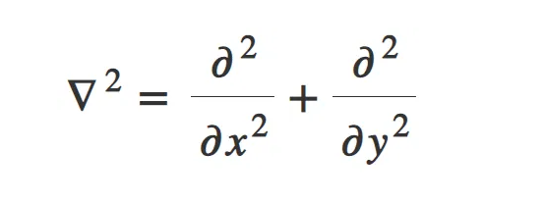
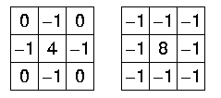
Laplacian edge detection
Second order derivate:
Unlike first-order filters that detect the edges based on local maxima or minima, Laplacian detects the edges at zero crossing i.e. where the value of the derivative changes from negative to positive and vice-versa
Two commonly used Laplacian Kernel

Slide 11
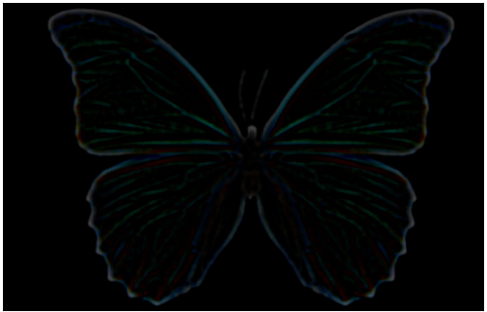
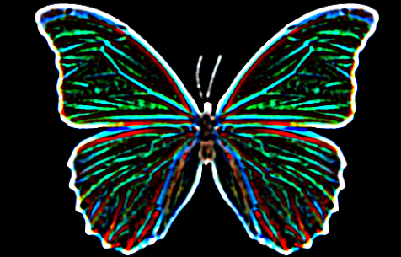
After Laplacian , kernel =3
After Laplacian , kernel =5

Slide 12
First derivative or second derivative?
First Derivative ( Sobel Operator):
Pros:
The first derivative methods are generally less sensitive to noise compared to second derivative methods. They can provide more robust results in noisy images.
They offer directional information about edges, which can be useful for tasks where edge orientation is important.
Cons:
They may not always detect edges accurately in regions with low-contrast or gradual intensity changes.
First derivative methods can be affected by variations in illumination, which might lead to false detections.
Second Derivative ( Laplacian Operator):
Pros:
Second derivative methods can detect edges more accurately at precise locations, especially for sharp and abrupt intensity changes.
They are less affected by variations in illumination compared to first derivative methods.
Cons:
They are more sensitive to noise, which can lead to false detections and spurious edges, particularly in noisy images.
Second derivative methods typically do not provide directional information about edges.

Slide 13
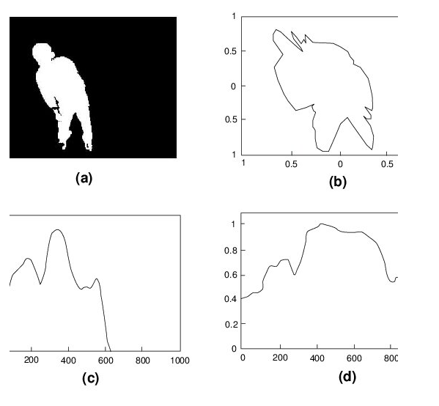
feature extraction techniques like blob detection using Laplacian of Gaussian (LoG) filters.
Blob detection is the process of identifying and localizing blobs in an image. The goal of blob detection is to find regions of an image that are significantly different from their surroundings and represent a meaningful feature or object.
Once blobs have been extracted from an image, they need to be represented in a way that is suitable for further processing and analysis. One common representation is to use a binary image, where the blobs are represented as white pixels and the background as black pixels. Other representations can include using a set of features or descriptors that describe the size, shape, and texture of the blobs.

Slide 14
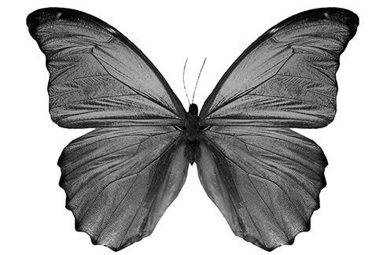
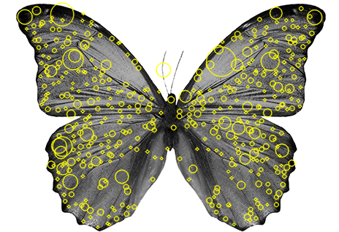
Laplacian of Gaussian
Determinant of Hessian

Slide 15
Why circles?
When the blob detector algorithm detects a blob, it returns a set of keypoints, each representing a detected blob. Each keypoint typically includes information such as the location (x, y coordinates) and the size of the blob. The algorithm draws a circle around each detected blob using this information, with the center of the circle indicating the location of the blob and the radius indicating the size of the blob

Slide 16
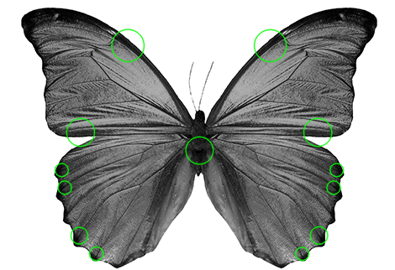
Unsuccessful findings
Why unsuccessful?
Gaussian Blur: The original image is first subjected to Gaussian blurring using a kernel size of (15, 15). This blurring operation smooths out the image and reduces high-frequency details, making it harder for the blob detector to identify distinct regions or blobs in the image.
Uniform Image Addition: A completely uniform image (filled with a gray color) is created, which essentially introduces a uniform background into the image. This uniform background provides no meaningful features or blobs for the blob detector to detect.
Combining Images: The blurred image and the uniform image are combined using an additive operation. This results in an image where the blurred content from the original image is mixed with the uniform background. However, due to the dominant presence of the uniform background, the resulting image contains regions with little to no meaningful features or blobs.
Blob Detection: The blob detector algorithm is then applied to this combined image. Since the image primarily consists of a uniform background with very few meaningful features, the blob detector may struggle to distinguish between true blobs and noise. It may detect false positive keypoints in regions where there are no meaningful blobs or features.

Slide 17
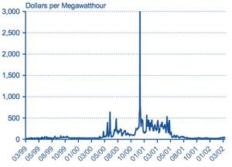
Derivative in Real life
Energy Derivatives
Energy derivatives are a valuable tool used by industrial companies and financial traders. For companies, energy derivatives can help smooth out production budgets, allowing them to secure prices ahead of time for the commodities they need in their manufacturing lines
Example: For example, an airline that requires a set amount of fuel to run its operations can secure that fuel at a predetermined price by buying futures contracts ahead of time. That way, if the price of fuel suddenly increases during the year, the company will not suffer from any unexpected increase in its costs.

Slide 18

Benzene Derivatives
benzene derivatives can also serve as an example of how derivatives are applied in real-world scenarios, particularly in the chemical industry. Benzene derivatives are organic compounds derived from benzene by replacing one or more hydrogen atoms with functional groups such as methyl, ethyl, nitro, or halogen groups.

Slide 19
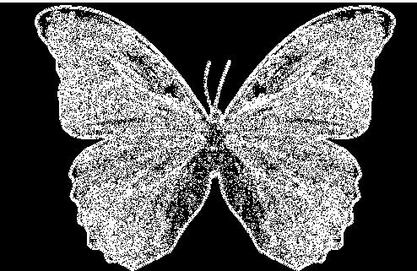
Third derivative approximation
does not directly compute the third derivative, it attempts to approximate its effect by applying the Laplacian operator twice

Slide 20
Enhancing Image Sharpness:
Edge detection helps improve the sharpness and clarity of printed images by enhancing the contrast between different regions. By identifying edges and boundaries, edge detection algorithms can enhance the visual appearance of edges, making them appear sharper and more defined in the printed output.

Slide 21
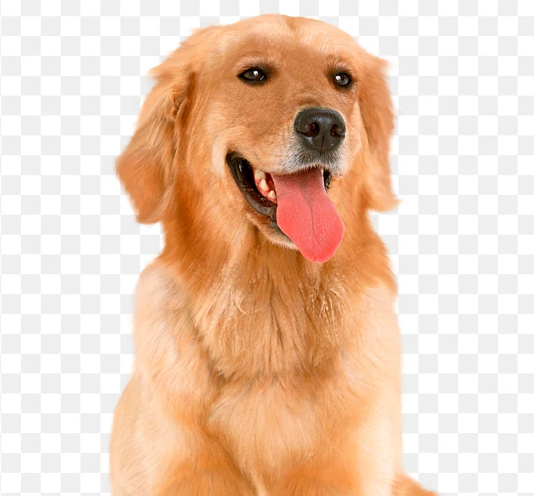

Original image:
Sharpened Image

Slide 22
Why this combination works? Edge detection and image sharpening complement each other in enhancing the visual quality and clarity of images. Edge detection identifies the locations of edges, while image sharpening enhances the contrast and definition of these edges. By first detecting edges using the Canny edge detector and then applying image sharpening, the code aims to further enhance the visibility and sharpness of the detected edges, resulting in an image with clearer and more defined edges.
Tools utilized :
OpenCV provides an implementation of the Canny edge detector through vc.Canny() function which takes the grayscale input image and two threshold values as parameters,
Cv.filter2D() - for applying convolution filters to images . I in this code, sharpening kernel is defined and applied to the original image

Slide 23
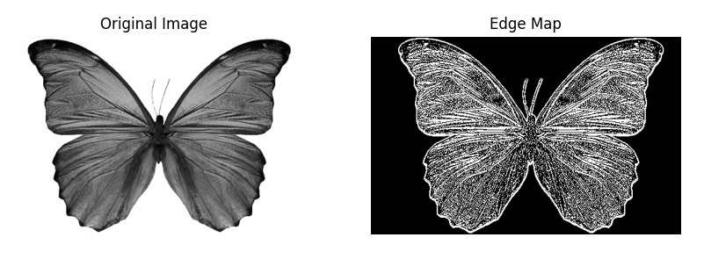
Combination derivative for edge detection
coeff_log = 0.7 coeff_directional = 0.4

Slide 24
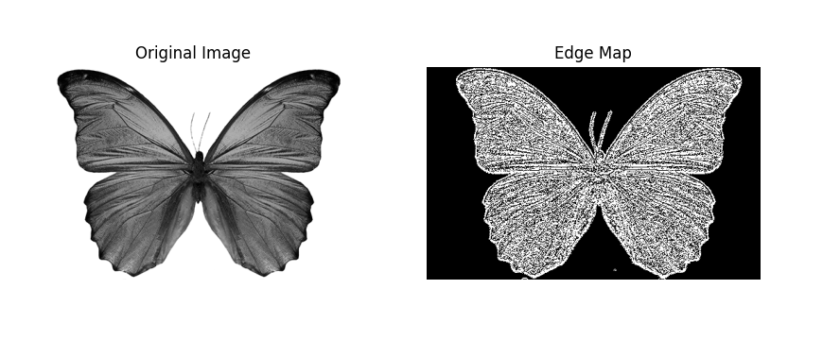
coeff_log = 16 coeff_directional = 98

